Slide 1






Marcy Cafe
data cleanup and insights
by Ibrahima Diallo and Vincent Perez

Slide 2
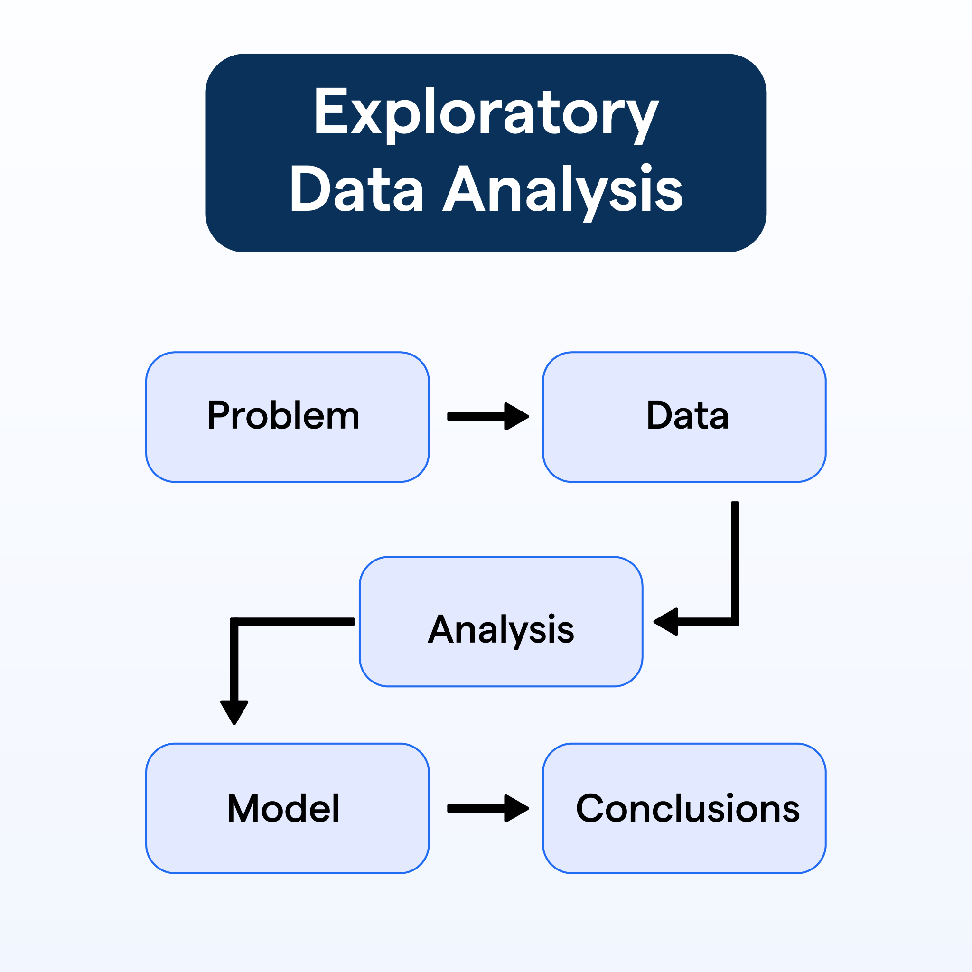
How can Marcy Cafe increase in sales performance?
1
Data Cleaning in Python
2
Data Cleaning in Excel
3
EDA Findings
4
Recommendations

Slide 3
Project overview
This project was conducted to help Marcy Cafe better understand their sales trends. By analyzing transaction-level data, we aimed to identify peak sales times, best-selling items, and customer behavior across the week and year. The insights are intended to guide smarter inventory and marketing decisions.

Slide 4
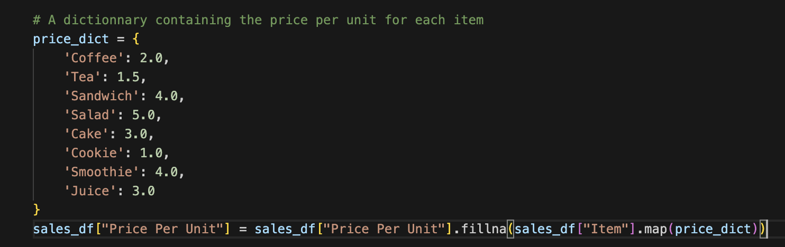
Data Cleaning In Python
Replaced 'ERROR' and 'UNKNOWN' values with NaN
Converted Transaction Date to correct data types (datetime), Price per unit, Quantity, and Total Spent to numeric (float)
Used dictionaries to fill missing item names based on price
Calculated missing Total Spent, Quantity, and Price Per Unit values using cross-column logic
Added new columns: Month and Day of the Week

Slide 5
Excel Cleaning
1
2
3
4
Replaced all Error/Unknown/or Blank values to NA for numeric data or Unknown for Addresses, Item names or Payment Methods
Filled in as many Unknown/NA values through filtering of data with Quantity 1 for Price per Unit
With math, was able to find NA Quantities and NA total price
After extensive cleaning, only 480 of the items were unknown, which is less than 5% of the data. Ensuring accuracy of analysis

Slide 6
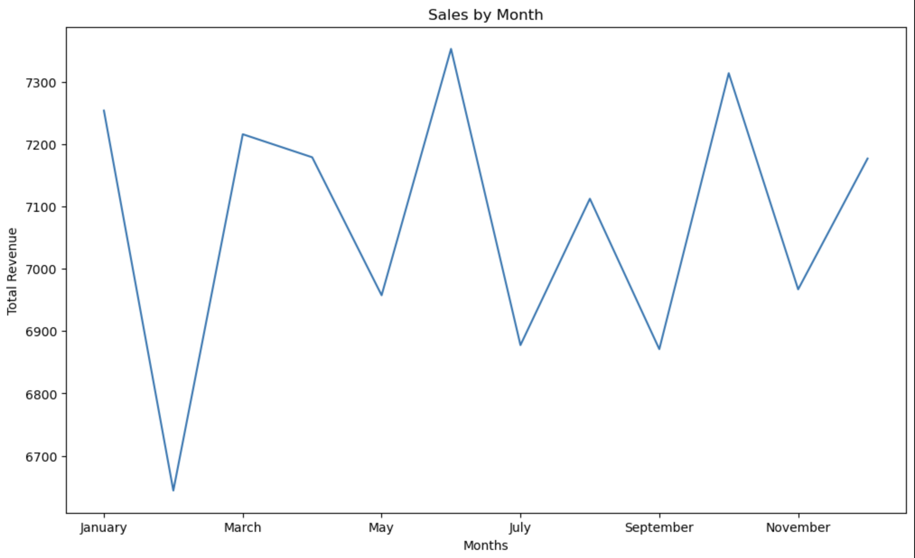
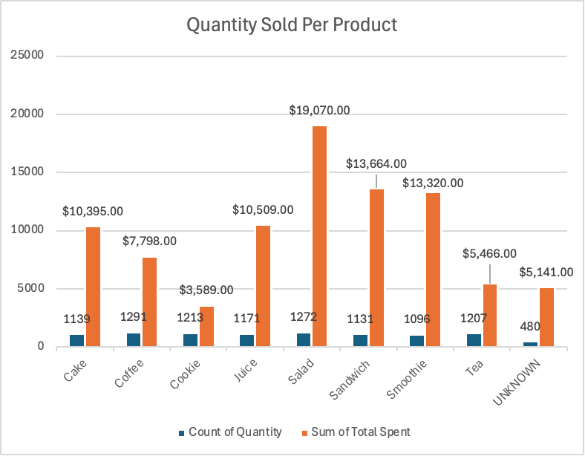
What does our EDA show about Marcy Cafe?
Top Selling Items
Payment
Salad, Sandwich, and Smoothie are best selling products
Weekends are busier than weekdays
Best sales month
June is the most profitable month of the year
Payment method was equally distributed across categories, each taking 33% of the total sales.
Best sales by day
Maximum sales on Thursday with $12,401 in total sales.
Total of 480 UNKNOWN items in data, unaccounted within data.
39/84 months in the year’s revenue were less than the median revenue
UNKNOWN data summed up to a total of $5,141, over 5% of total revenue
Cookie was 3rd most sold item, but made the least revenue
Location data was unusable, as 3961/5000 entries were unknown
Least profitable day was right after most profitable month
Many UNKNOWN entries
Potential Gain in Revenue

Slide 7
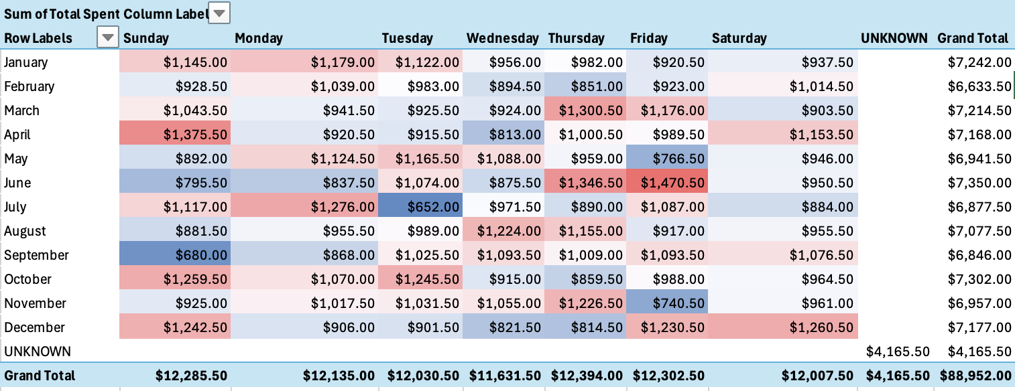
What do we recommend for Marcy Cafe?
1
Increased Inventory
Sandwiches and Salads are our most profitable items according to the data, we can avoid going out of stock by increasing our inventory for these items.
2
Increased Staffing
During busier hours (Thursday and Weekends), provide more staffing to support. Could potentially lead to higher revenue.
3
Experiment with Slow Months
Use slow months to experiment with discounts or new menu items. (ex. bundling cookies to improve sales for cookies during February)
4
Improve Data Collection
We could make more accurate insights if our raw data didn’t have as many unknown/error/blank values in the future.

Slide 8
Final Thoughts
A clean dataset can unlock valuable insights and enable confident decision-making
Working with this cafe data helped us understand the full data lifecycle—from cleaning and wrangling to visualizing and interpreting results.
Using Python, Excel, and charts gave us the power to turn raw numbers into clear insights.
This project gave me confidence that I can analyze real business problems and explain them clearly to others.

